Slide 1
Music Sentiment Analysis
By
Rahul Purushottam Gaonkar (rpg283)
Manish Nagdevani (man514)
Seo Gregory Pallichirayil (sgp322)

Slide 2

Inspiration
Problem Faced
Most of the music apps give recommendations of songs based on artist, songs played, etc
It doesn’t take into consideration the mood or sentiment of the songs being played by the user
This might result in the user manually searching for songs based on his mood

Slide 3
Solution
Create a mood or sentiment based music recommender system
Based on the mood of the previously played songs, recommend the user songs of similar sentiment or mood

Slide 4
Data Set
Labelled music dataset with lyrics
https://github.com/rasbt/musicmood/tree/master/dataset/training
SenticNet 4
http://sentic.net/senticnet-4.0.zip
Libraries used:
nltk.stem.porter (Stemming)
nltk.stem.wordnet (Lemmatization)
nltk.sentiment.vader (Lyrics Polarity Assignment)
Technologies Used:
Pyspark , R , Python

Slide 5
Architecture
Dataset
(CSV files)
Data-Cleaning
Tokenization
Stop Word Removal
Lemmatization/ Stemming
Feature and label Extraction
(TF IDF / Count Vectorizer /Assigned Lyrics Polarity / String Indexer)
Splitting to Training and Test Dataset
Training and Testing ML Model
(Using Cross Validation)
Data Visualization of Predicted Dataset

Slide 6
Comparing ML Models
Accuracy
ML Models

Slide 7
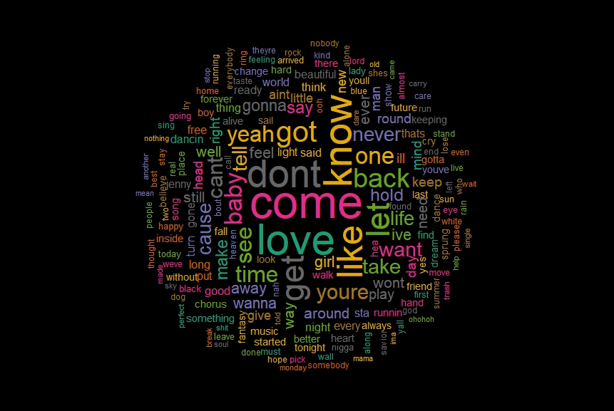
Word Cloud of Happy Words

Slide 8
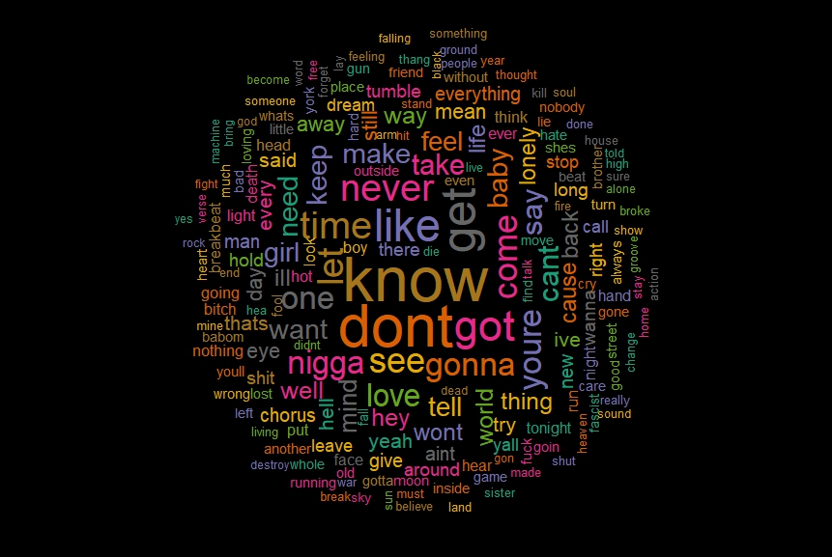
Word Cloud of Sad WORDS

Slide 9
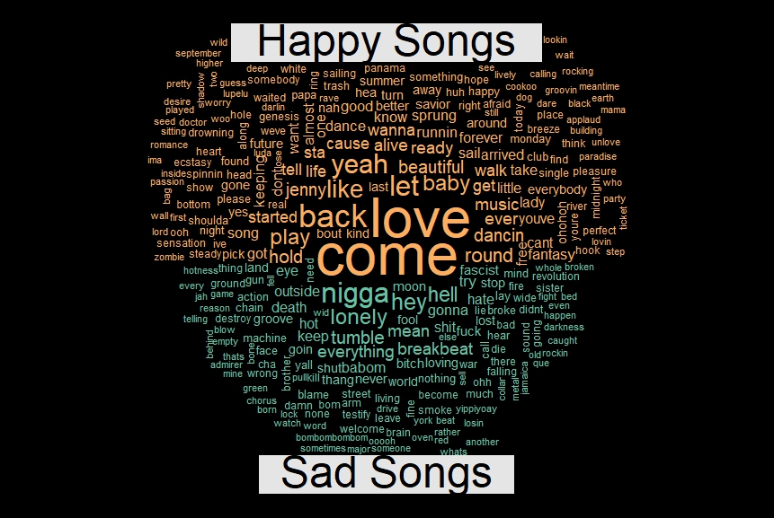
Comparison CLOUD

Slide 10
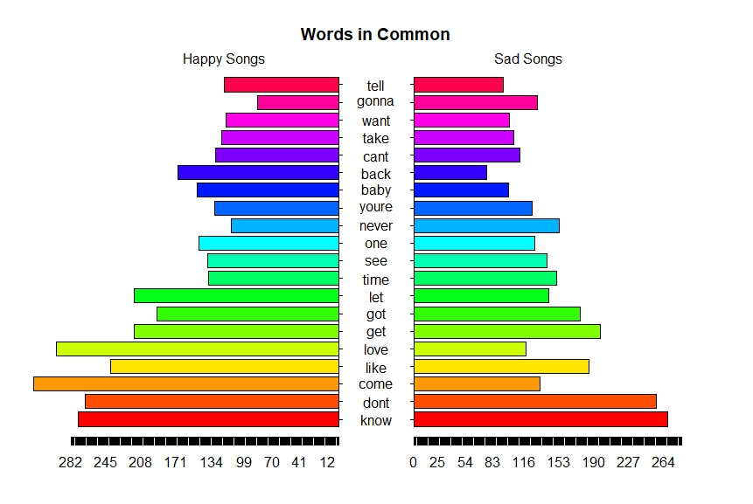
Pyramid Plot

Slide 11
Challenges faced
One of the major challenge was finding an already labelled dataset of songs by sentiment
We managed to find a training dataset, but it was limited to 1000 songs
PySpark ML models did not directly support PMML format for saving. So, it was difficult to integrate it in a music application

Slide 12
Future Work (Scope of the project)
Merge the ML model with an existing music application to provide better recommendation of songs to users.
To provide different tabs for recommendation of songs like by mood, genre, artist, etc
To add more types of sentiments/ labels like romantic, motivational etc.

Slide 13
References
E. Cambria, S. Poria, R. Bajpai, and B. Schuller. SenticNet 4: A semantic resource for sentiment analysis based on conceptual primitives. In: COLING, pp. 2666-2677 (2016)
Sebastian Raschka : MusicMood. https://github.com/rasbt/musicmood

Slide 14


